Slide 1
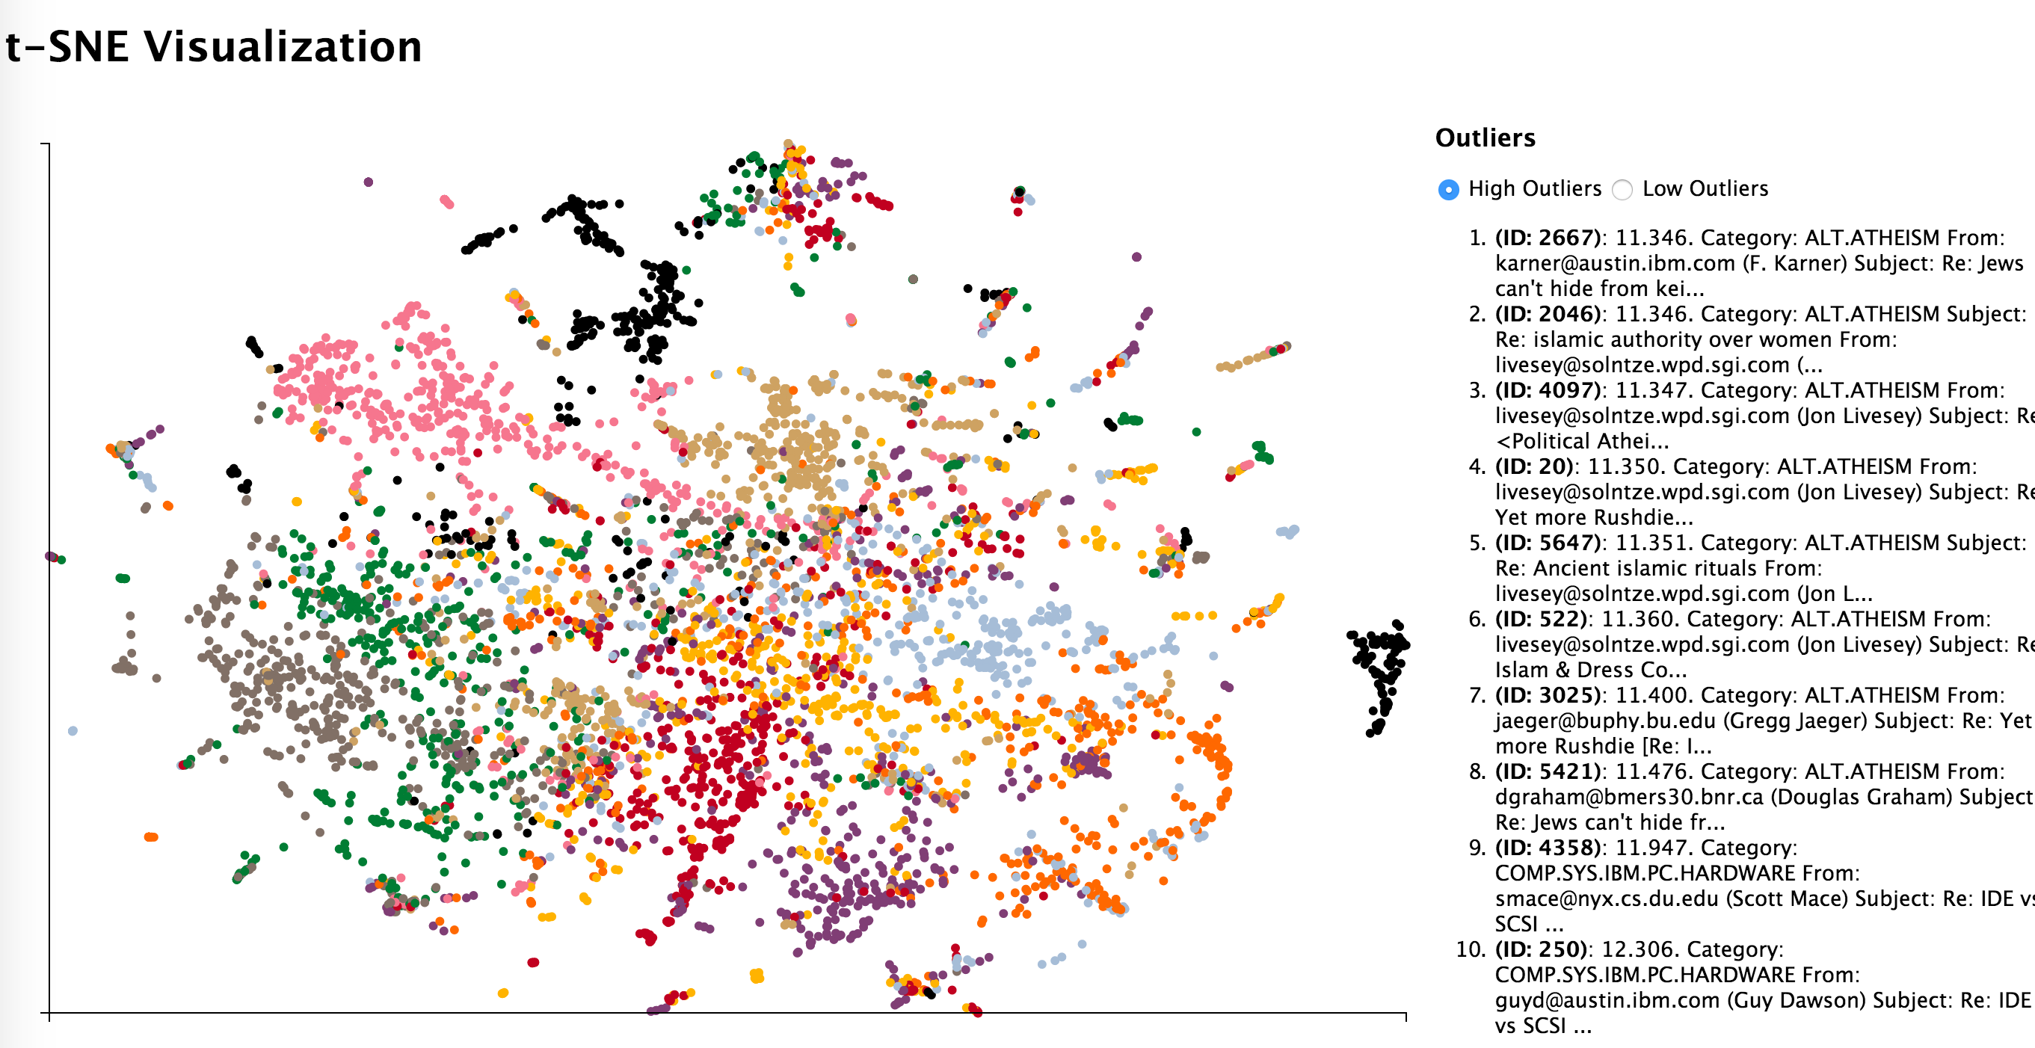
Server
RethinkDB
(B)
Change Notification
Web Client
(C)
Database Updated Event
(E)
Database
Update
(A) Database
Update
Node.js Server
(F)
Change Notification
(D)
Point Updated Event
t-SNE Algorithm

Slide 2
